Slide 1
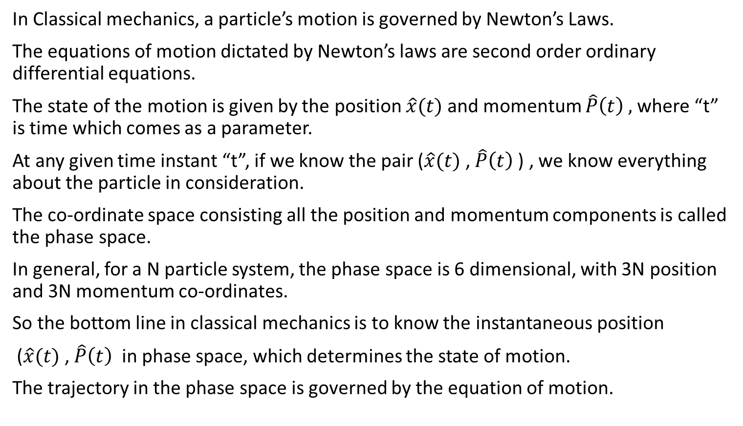
Lecture 2: Introduction to Hilbert space
In Classical mechanics, a particle’s motion is governed by Newton’s Laws.
The equations of motion dictated by Newton’s laws are second order ordinary differential equations.
The state of the motion is given by the position $\hat{x}(t)$ and momentum $\hat{P}\left(t\right) ,$where “t” is time which comes as a parameter.
At any given time instant “t”, if we know the pair ($\hat{x}(t)$ , $\hat{P}\left(t\right)$) , we know everything about the particle in consideration.
The co-ordinate space consisting all the position and momentum components is called the phase space.
In general, for a N particle system, the phase space is 6 dimensional, with 3N position and 3N momentum co-ordinates.
So the bottom line in classical mechanics is to know the instantaneous position
($\hat{x}(t)$ , $\hat{P}\left(t\right)$ in phase space, which determines the state of motion.
The trajectory in the phase space is governed by the equation of motion.

Slide 2
Quantum Mechanics
In Quantum mechanics, the basic question remains the same: What is the state of motion ?
The state of motion cannot be determined by the point in phase space.
We have to consider uncertainty principle.
Position and momentum cannot be determined with perfect accuracy simultaneously.
Also the entity obeying quantum mechanics do not obey Newton’s Laws.
Therefore we need a new “space” and a new “Principles of motion”

Slide 3
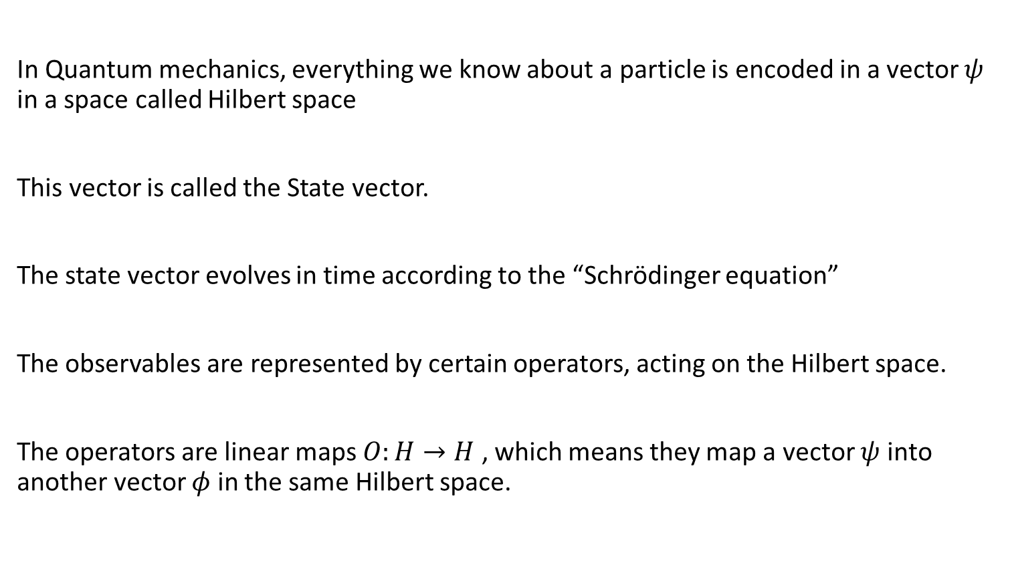
We need Hilbert space
In Quantum mechanics, everything we know about a particle is encoded in a vector $ψ$ in a space called Hilbert space
This vector is called the State vector.
The state vector evolves in time according to the “Schrödinger equation”
The observables are represented by certain operators, acting on the Hilbert space.
The operators are linear maps $O:H→H$ , which means they map a vector $ψ$ into another vector $φ$ in the same Hilbert space.

Slide 4
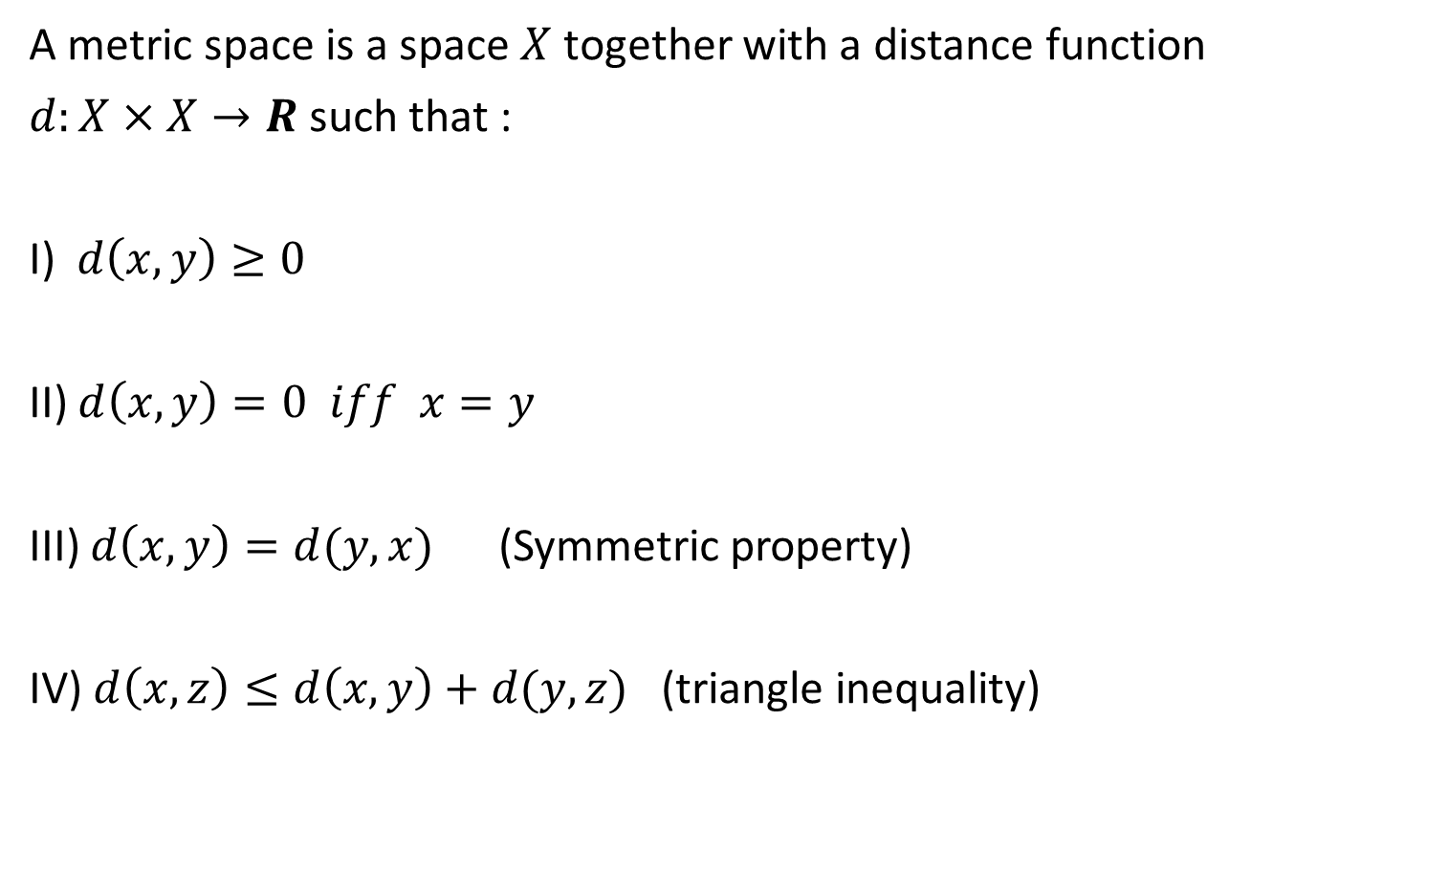
Metric Space
A metric space is a space $X$ together with a distance function
$d:X×X→R$such that :
I) $d\left(x,y\right)≥0$
II) $d\left(x,y\right)=0 iff x=y$
III) $d\left(x,y\right)=d(y,x)$ (Symmetric property)
IV) $d\left(x,z\right)≤d\left(x,y\right)+d(y,z)$ (triangle inequality)

Slide 5
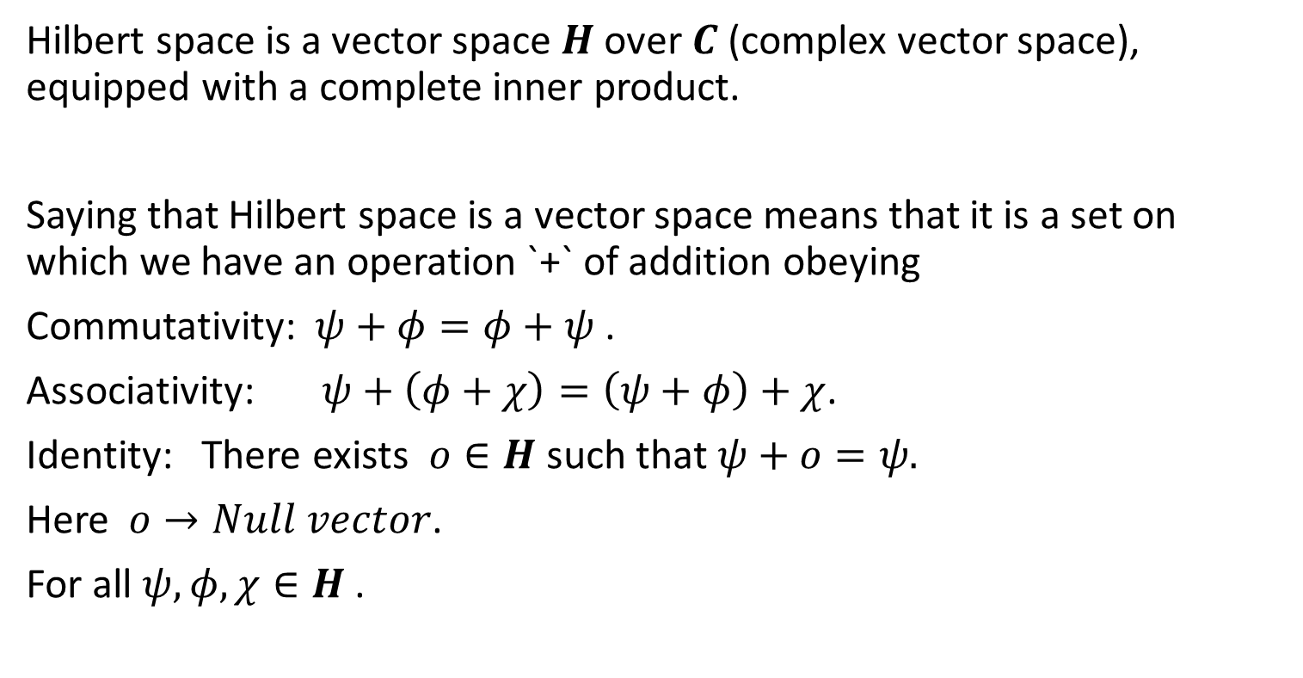
Hilbert Space
Hilbert space is a vector space $H$ over $C$ (complex vector space), equipped with a complete inner product.
Saying that Hilbert space is a vector space means that it is a set on which we have an operation `+` of addition obeying
Commutativity: $ψ+φ=φ+ψ$.
Associativity: $ψ+\left(φ+χ\right)=\left(ψ+φ\right)+χ$.
Identity: There exists $o∈H$ such that $ψ+o=ψ.$
Here$o→Null vector$.
For all $ψ, φ, χ∈H$ .

Slide 6

Multiplication by a complex scaler:
The multiplication operation is
i) Distributive over $H$: $c\left(ψ+φ\right)=cψ+cφ$.
ii)Distributive over $C$ : $\left(a+b\right)ψ=aψ+bψ$.

Slide 7
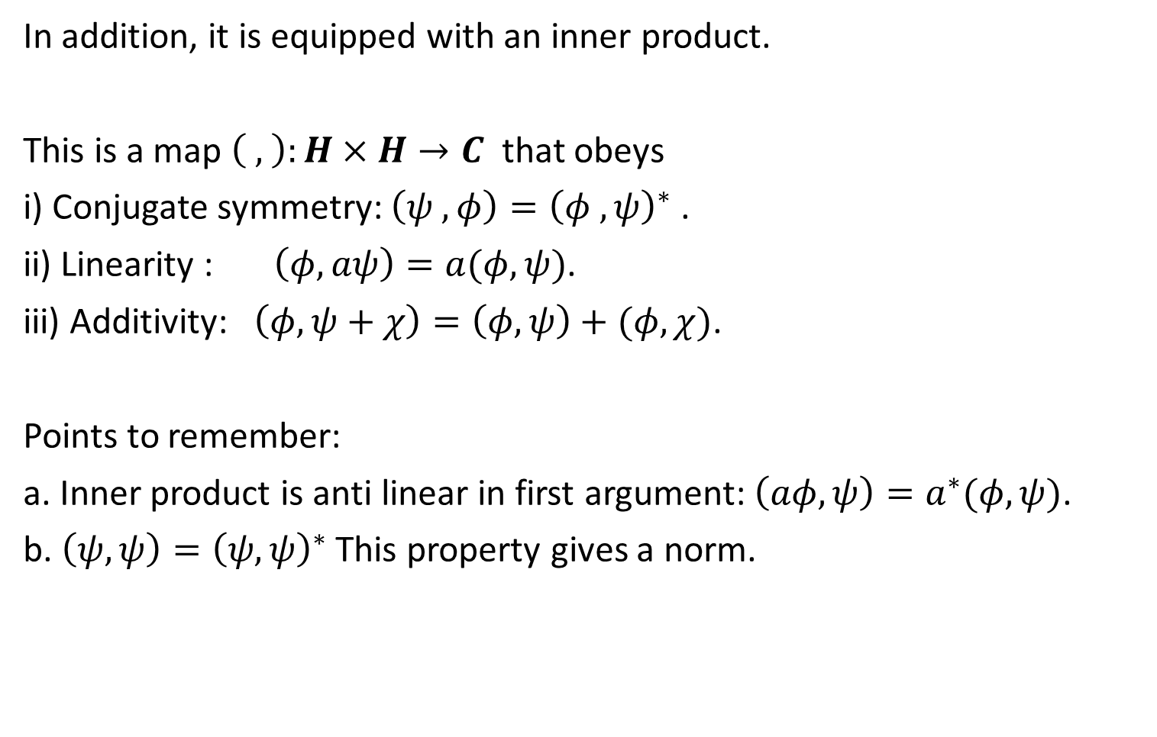
In addition, it is equipped with an inner product.
This is a map $\left( , \right):H×H→C$ that obeys
i) Conjugate symmetry: $\left(ψ , φ\right)={\left(φ , ψ\right)}^{∗}$ .
ii) Linearity : $\left(φ, aψ\right)=a(φ, ψ)$.
iii) Additivity: $\left(φ, ψ+χ\right)=\left(φ,ψ\right)+(φ,χ)$.
Points to remember:
a. Inner product is anti linear in first argument: $\left(aφ,ψ\right)=a^{∗}(φ,ψ)$.
b. $\left(ψ,ψ\right)={\left(ψ,ψ\right)}^{∗}$ This property gives a norm.

Slide 8
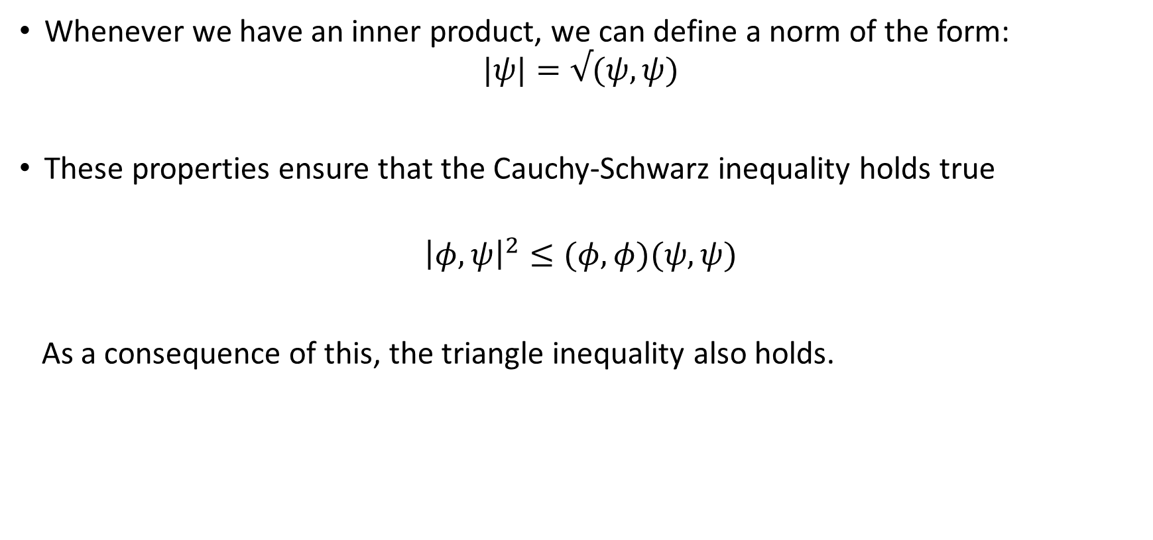
Norm
Whenever we have an inner product, we can define a norm of the form:
$$|ψ|=√(ψ,ψ)$$
These properties ensure that the Cauchy-Schwarz inequality holds true
$${\left|φ,ψ\right|}^{2}≤(φ,φ)(ψ,ψ)$$
As a consequence of this, the triangle inequality also holds.

Slide 9
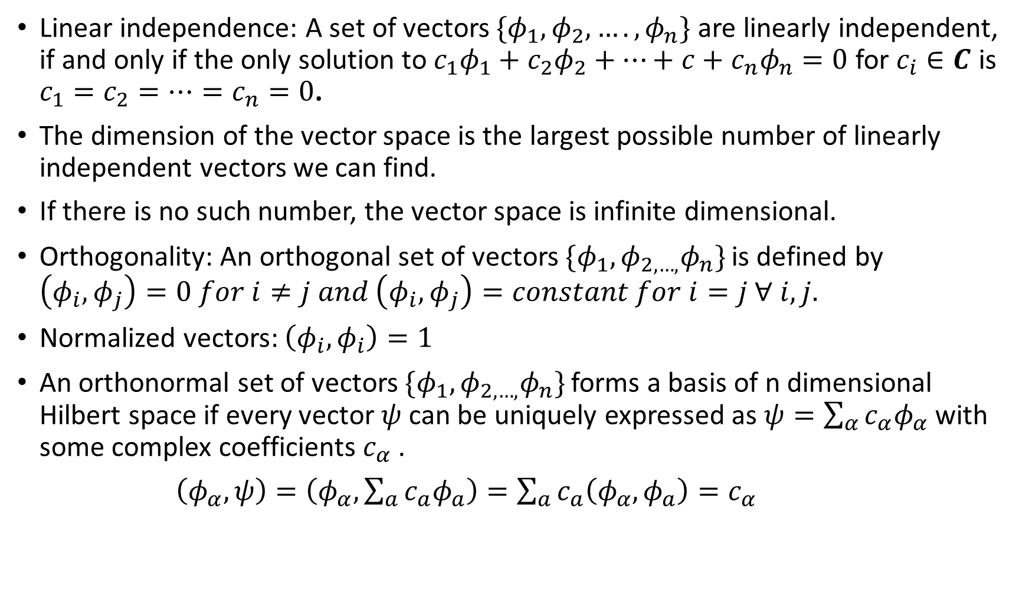
Linear independence: A set of vectors $\{φ_{1},φ_{2},….,φ_{n}\}$ are linearly independent, if and only if the only solution to $c_{1}φ_{1}+c_{2}φ_{2}+…+c+c_{n}φ_{n}=0$ for $c_{i}∈C$ is $c_{1}=c_{2}=…=c_{n}=0$.
The dimension of the vector space is the largest possible number of linearly independent vectors we can find.
If there is no such number, the vector space is infinite dimensional.
Orthogonality: An orthogonal set of vectors $\{φ_{1},φ_{2,…,}φ_{n}\}$ is defined by $\left(φ_{i},φ_{j}\right)=0 for i≠j and \left(φ_{i}, φ_{j}\right)=constant for i=j ∀ i,j.$
Normalized vectors: $\left(φ_{i},φ_{i}\right)=1$
An orthonormal set of vectors $\{φ_{1},φ_{2,…,}φ_{n}\}$ forms a basis of n dimensional Hilbert space if every vector $ψ$ can be uniquely expressed as $ψ=\sum_{α}{c_{α}φ_{α}}$ with some complex coefficients $c_{α}$ .
$\left(φ_{α},ψ\right)=\left(φ_{α},\sum_{a}{c_{a}φ_{a}}\right)=\sum_{a}{c_{a}\left(φ_{α},φ_{a}\right)=c_{α}}$

Slide 10
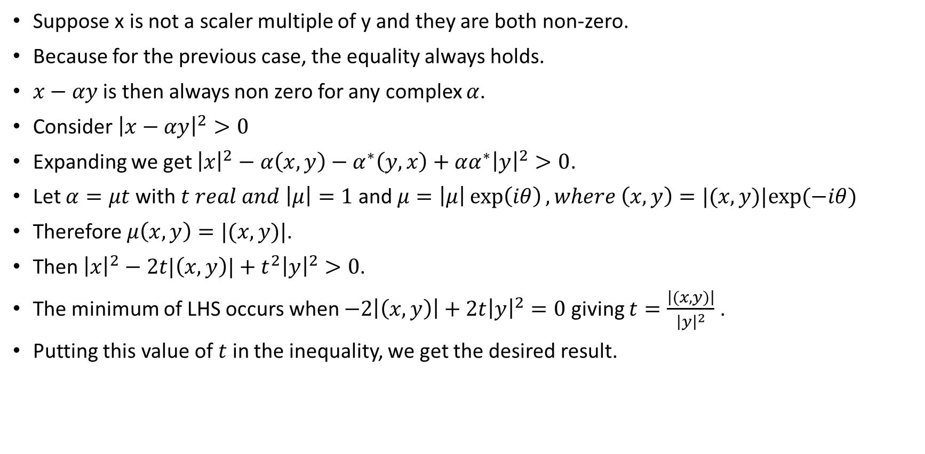
Cauchy-Schwarz inequality ${\left|\left(x,y\right)\right|}^{2}≤(x,x)(y,y)$
Suppose x is not a scaler multiple of y and they are both non-zero.
Because for the previous case, the equality always holds.
$x−αy$ is then always non zero for any complex $α$.
Consider ${\left|x−αy\right|}^{2}>0$
Expanding we get ${\left|x\right|}^{2}−α\left(x,y\right)−α^{∗}\left(y,x\right)+α{α^{∗}\left|y\right|}^{2}>0$.
Let $α=μt$ with $t real and \left|μ\right|=1$and $μ=\left|μ\right|\exp\left(iθ\right), where \left(x,y\right)=|(x,y)|exp⁡(−iθ)$
Therefore $μ\left(x,y\right)=|(x,y)|$.
Then ${\left|x\right|}^{2}−2t|\left(x,y\right)|+t^{2}{\left|y\right|}^{2}>0$.
The minimum of LHS occurs when $−2\left|\left(x,y\right)\right|+2t{\left|y\right|}^{2}=0$ giving $t=\frac{\left|(x,y)\right|}{{\left|y\right|}^{2}}$ .
Putting this value of $t$ in the inequality, we get the desired result.

Slide 11

Triangle inequality : $\left|v+w\right|≤\left|v\right|+|w|$
${\left(\left|v\right|+\left|w\right|\right)}^{2}−{\left|v+w\right|}^{2}$
${=\left|v\right|}^{2}+{\left|w\right|}^{2}+2\left|v\right|\left|w\right|−{\left|v\right|}^{2}−{\left|w\right|}^{2}−\left(v,w\right)−\left(w,v\right)$
$=2\left|v\right|\left|w\right|−2Re\left(v,w\right)≥$ $2\left|v\right|\left|w\right|−2\left(v,w\right)≥0$.

Slide 12
Consider Cartesian Co-ordinate system in three dimension.
Verify all the properties of a vector space
What will be the inner product ?
Verify the Cauchy-Schwarz inequality and Triangle inequality.

